Slide 1
Configuration Management
Main issues:
manage items during software life cycle
usually supported by powerful tools

Slide 2
Configuration management tasks
identification and definition of configuration items, such as source code modules, test cases, requirements specification, the user manual – the baseline (approved)
managing changes and making configuration items available during the software life cycle, usually through a Configuration (Change) Control Board (CCB)
keeping track of the status of all items (including the change requests – baseline)
crucial for large projects
SE, Configuration Management, Hans van Vliet, ©2008
Notes:
© SE, Configuration Management, Hans van Vliet

Slide 3
Configuration Control Board
ensures that every change to the baseline (change request - CR) is properly authorized and executed
CCB needs certain information for every CR, such as who submits it, how much it will cost, urgency, etc.
CCB assesses the CR. If it is approved, it results in a work package which has to be scheduled.
so, configuration management is not only about keeping track of changes, but also about workflow management
SE, Configuration Management, Hans van Vliet, ©2008

Slide 4
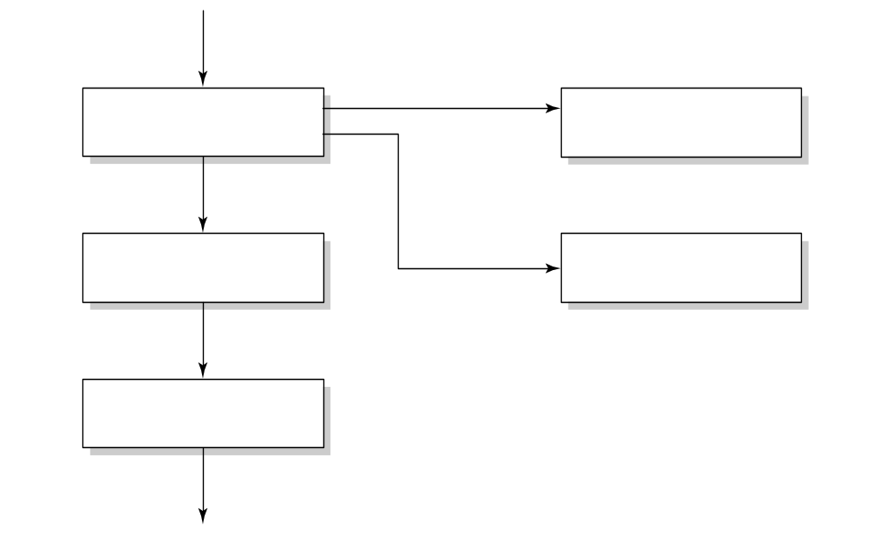
Workflow of a change request
change request (CR)
investigate
reject
notify owner
approve
schedule work
request info
defer
implement change
SE, Configuration Management, Hans van Vliet, ©2008

Slide 5
Tool support for configuration management
if an item has to be changed, one person gets a copy thereof, and meanwhile it is locked to all others
new items can only be added to the baseline after thorough testing
changes in the status of an item (e.g. code finished) trigger further activities (e.g. start unit testing)
old versions of a component are kept as well, resulting in versions, like X.1, X.2, …
we may even create different branches of revisions: X.2.1, X.2.2, … and X.3.1, X.3.2, ...
SE, Configuration Management, Hans van Vliet, ©2008

Slide 6
Functionalities of SCM tools
Components (storing, retrieving, accessing, …)
Structure (representation of system structure)
Construction (build an executable)
Auditing (follow trails, e.g. of changes)
Accounting (gather statistics)
Controlling (trace defects, impact analysis)
Process (assign tasks)
Team (support for collaboration)
SE, Configuration Management, Hans van Vliet, ©2008

Slide 7
Models of configurations
version-oriented: physical change results in a new version, so versions are characterized by their difference, i.e. delta
change-oriented: basic unit in configuration management is a logical change
identification of configuration becomes different: “baseline X plus fix table bug” instead of “X3.2.1 + Y2.7 + Z3.5 + …”
SE, Configuration Management, Hans van Vliet, ©2008

Slide 8
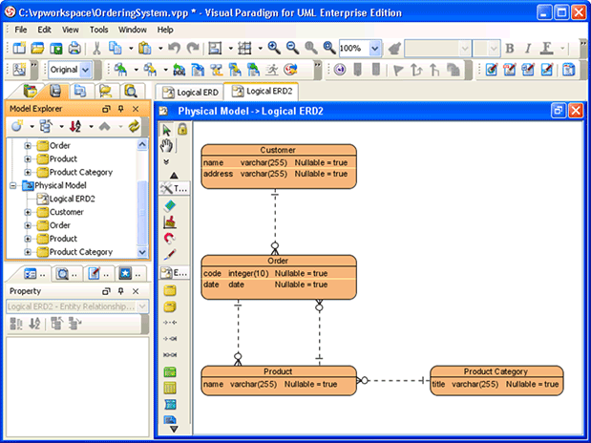
Models of configurations (Visual Paradigm 12.0 Professional Edition)
SE, Configuration Management, Hans van Vliet, ©2008

Slide 9
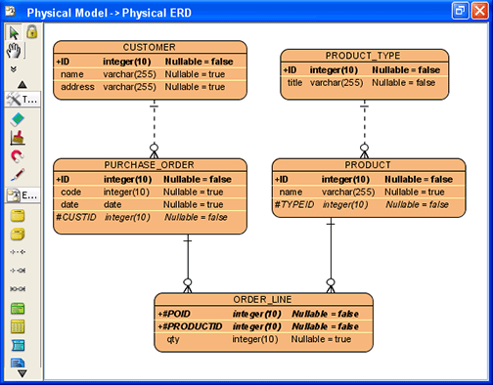
1NF, 2NF, 3NF
SE, Configuration Management, Hans van Vliet, ©2008

Slide 10
Evolution of SCM tools
Early tools: emphasis on product-oriented tasks
Nowadays: support for other functionalities too. They have become a (THE) major tool in large, multi-site projects
Agile projects: emphasis on running system: daily builds
SE, Configuration Management, Hans van Vliet, ©2008

Slide 11
Configuration Management Plan
Management section: organization, responsibilities, standards to use, etc
Activities: identification of items, keeping status, handling CRs
SE, Configuration Management, Hans van Vliet, ©2008

Slide 12

Summary
CM is about managing all kinds of artifacts during software development
Crucial for large projects
Supported by powerful tools
SE, Configuration Management, Hans van Vliet, ©2008

